Slide 1
Java SE 17 – Presentation
Chapter 6 – Class Design
and
Chapter 7 – Beyond Classes

Slide 2
New things
New keyword for classes
sealed
non-sealed
static
Overloading constructors
Rule: ... must be at the ... line
(code illustration snippet 1)
(code illustration snippet 2)
(code illustration snippet 3)

Slide 3
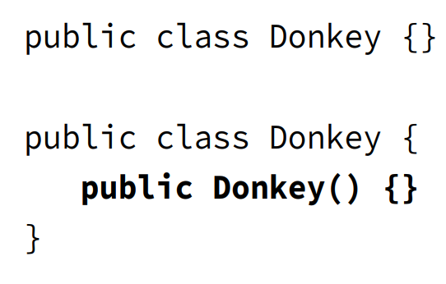
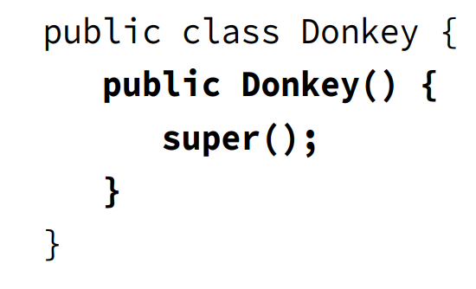
Revision
- Explain these pictures

Slide 4
Revision
(code illustration snippet 4)
Initializing final field
- static final field is ... only ... => It must be ... in the same ...
- However, ... variable is initialized when ... ran => final ... variable will be able to be ... in ..., ... , or ...
(code illustration snippet 5,6)
Order of initializing instances
1:
2:
3:
4:
5:

Slide 5
Revision
- Note: Why can we declare final ... in ... ?
– JLS specifies: final instance variable must be ... and ...
– What does this mean ? This means that the field must be ... on all ... (all ... here means all ...)
- ... means that there must be no ... before ...
HARD RULE: this() ... super() ...
(code illustration snippet 7,8,9,10)
Overriding a method
- Rules when overriding a method
+)
+)
+)
+) (note: This is related to designing programming language => Can't be easily proved)
Note: If super doesn't have ... while sub has ... => ...

Slide 6
Revision
Redeclaring private methods
- Since ... method can't be ... by sub ... => sub... can ...
(code illustration snippet 11)
Hiding static method
- Rules when hiding static method
+) If called using ... name
-) If in ... =>
-) If in ... =>
+) If called using ref ...
-) If both ...
-) If both ...
-) If ...
(code illustration snippet 12)

Slide 7
Revision
Hiding variables
- There are ... cases for variable hiding
+) ... access
-) If both ...
-) If both ...
-) To access super ... uses ..., ... with super ..., ... if static ..., or ref ...
+) Access using ...
-) If ... not =>
-) If ... =>
(note: these cases are applicable for ... variables and without ...)
(code illustration snippet 13)
Creating Abstract classes
- If the ... class doesn't has ... => All ...
(code illustration snippet 14)

Slide 8
Revision
(code illustration snippet 15)
Note: If any classes that ... the class ... => The sub ... will ...
(code illustration snippet 16)
- Note: Static can't ... => can't marked ...
– ... class = first class ...
(code illustration snippet 17)
- Although abstract class can't ... It still can be able to have ...
– However, only ... can call ... thorugh ...
(question 2)
(code illustration snippet 18)
- We can't mix ... and ...

Slide 9
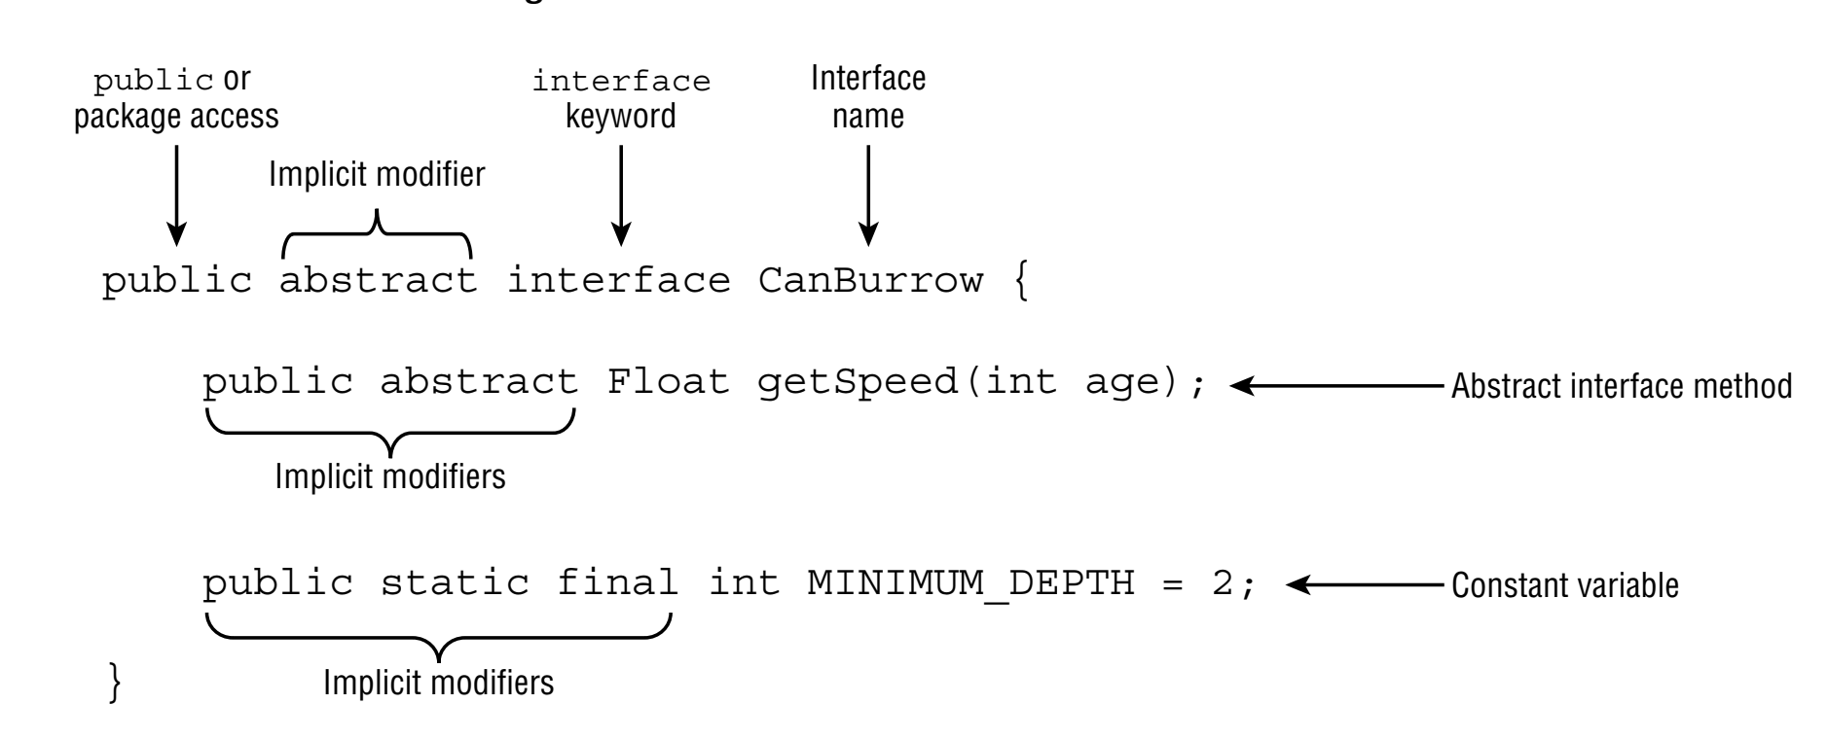
Revision – Chapter 7
Implementing Interface
- Interface can't be ... using ...
- Interface can't be mixed with ... because it is used for ...

Slide 10
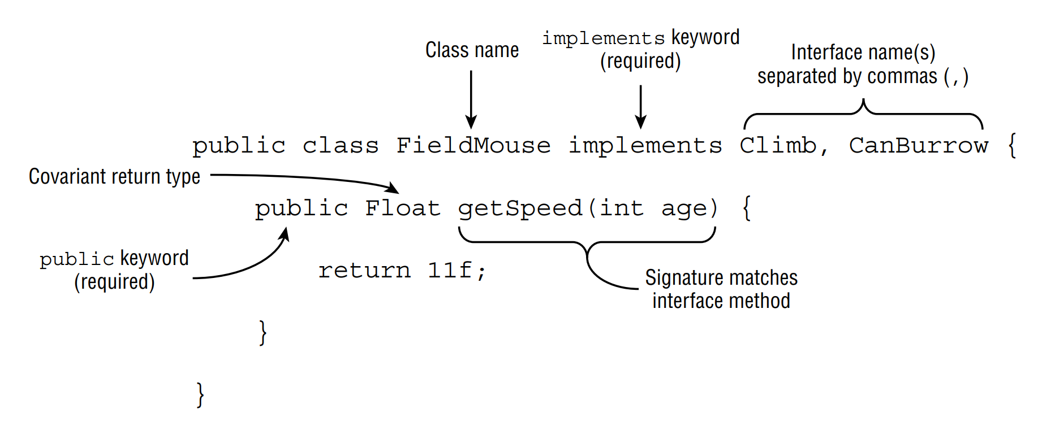




Revision
-
- Interface can ... other ...
(code illustration snippet 19)
- ... is allowed in Interface

Slide 11
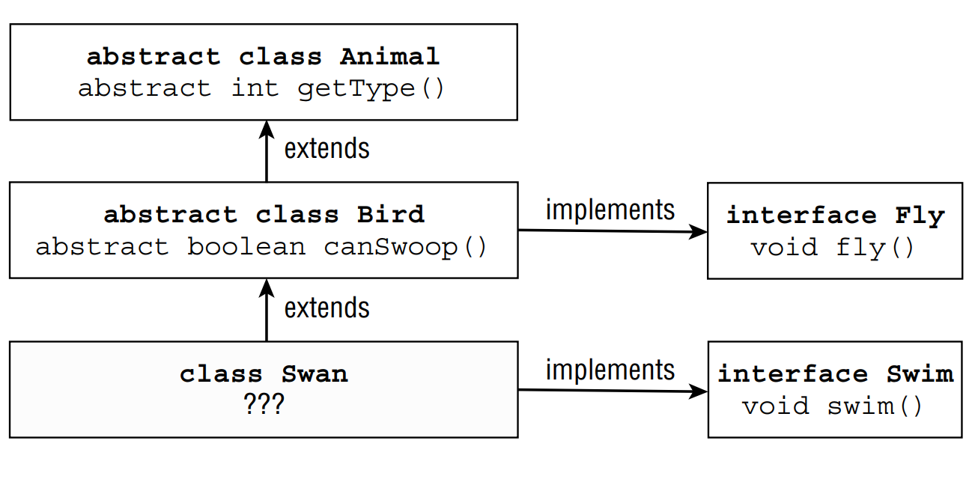

Revision – Chapter 7
-

Slide 12
Revision
Inheriting duplicate abstract method
(code illustration snippet 20)
- In order to do this, 2 methods ... or else ...
(code illustration snippet 21)
- Starting from Java 9, ... is allowed in Interface
– Any other ... aren't allowed

Slide 13
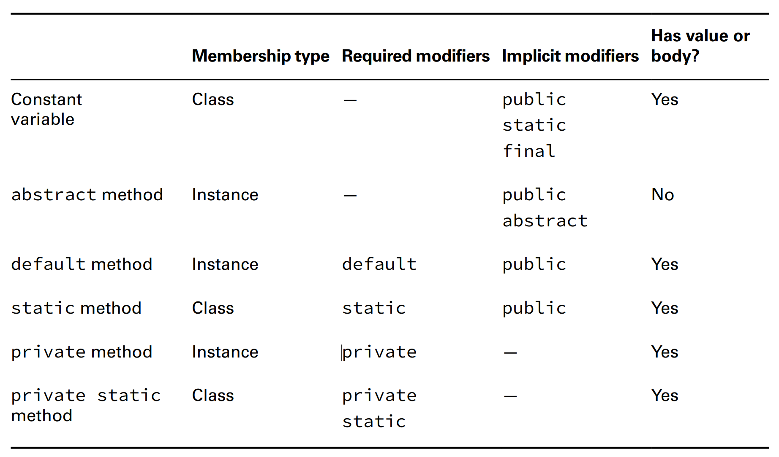
Revision

Slide 14
Revision
- ... modifier can be used for ...
(code illustration snippet 22)
- However, there is a way to ... is ... the method ...
(code illustration snippet 23)
- In order to access ... inside the interface when the method has been ... => We use a special syntax
(code illustration snippet 24)
Reusing code with "private" interface method
- private interface method was created for ...
(code illustration snippet 25)
- Rules when using ...
+)
+)
+)

Slide 15
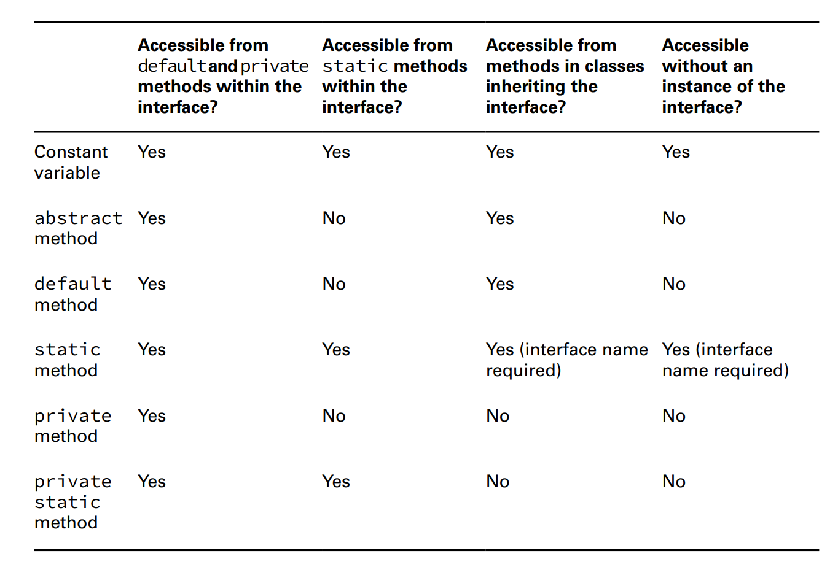
Revision

Slide 16
Revision
Note: To remember things easily, we just need to know that ... method can't be ... inside ...
(code illustration snippet 26)

Slide 17
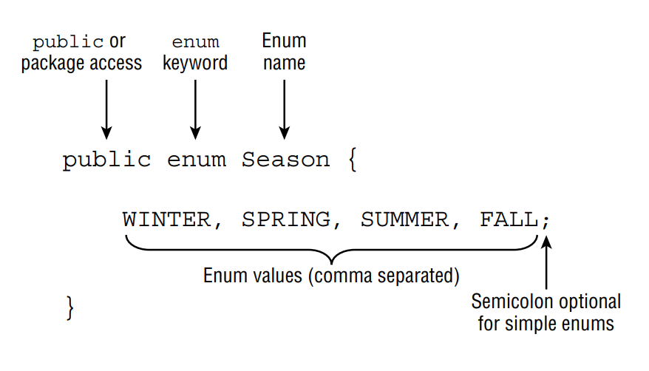


New things
Working with Enum
- In programming, we usually have to ... such as days ....
- Therefore, Java creates Enum – A ... set of ...
– Enum is better than a class ... bunch of ... because Enum has ... mechanism
– For ... and ..., we can pass an invalid ... but with ... this is impossible because it checks at ... time
- We use Enum when we have a ... set of ...

Slide 18
New things
(Note: All enums will ...)
- Since all values in enum are ... we are opted to use ... case
(code illustration snippet 27)
- We can use ... operators with enum since they are all ... => They are ... and ... once in ...
– One thing you can't do is ...
calling the values(), name(), and ordinal() methods
(code illustration snippet 28)
- Technically, Enum values are ... => It can't be ... with ...
(code illustration snippet 29)
valueOf() (question 3)
(code illustration snippet 30)

Slide 19
New things
Using Enums in switch statements
- Enum is the only ...
(code illustration snippet 31)
- We must ... syntax, or else ...
- Also mentioned, enum is ..., therefore, it can't be ....
(code illustration snippet 32)
Adding Constructors, Fields, and Methods
- ... enum, we can also have ... enum
(note: this time, the ... won't be ... anymore but it must be ...)
(code illustration snippet 33)
Note: ... field in enum is recommended ...
- Although we can set ... field to be ..., it is ... recommended since ... JVM (question 3)
- All enum ... private => This is understandable because ... call and enum can't be ...
- All parentheses in ... without the ... keyword. If we use ... for the first ... JVM will ... and after ...
(code illustration snippet 34)

Slide 20
New things
- If the OnlyOne enum has been ... before the ... => It won't
– We can also have different ... for each ...
(code illustration snippet 35)
- The syntax looks like we create ... and ... look like they are ...
- This is actually nearly correct because each ... is a ...
– But if we don't want this, we can ... and each ... or ...
(code illustration snippet 36)
- Enum can also ...
(code illustration snippet 37)
- Just because Enum can has ... doesn't mean it ...
- We must keep ...
- IMPORTANT: The ... first ... in enum

Slide 21
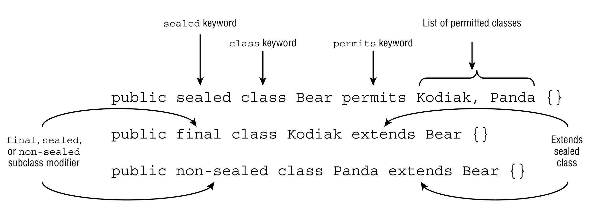


New things
Sealing classes
- To limit .... that can ... other classes, we use something called ...
- Sealed classes is a ... that ...
(this is brand new in ...)
- Note: the class that ... must ...
– Every subclass ... must have ... or else other ....

Slide 22
New things
Sealed class keywords
sealed
non-sealed
permits
(code illustration snippet 38)
- ... class usually declared with ... although this is ...
Compiling sealed classes
(code illustration snippet 39)
- Another rule is that the ... class must ...
(code illustration snippet 40)

Slide 23
New things
Specifying the subclass modifier
- All classes that ... the ... class must have ... ..., ..., or....
A final subclass
(code illustration snippet 41)
A sealed subclass
(code illustration snippet 42)
A non-sealed subclass
(code illustration snippet 43)
- If we are ... about sealed class is too ... for other .... We can know that the author ... see ... in ... time
Omitting the "permits" clause
- The "permits" clause is ...
(code illustration snippet 44,45,46)

Slide 24
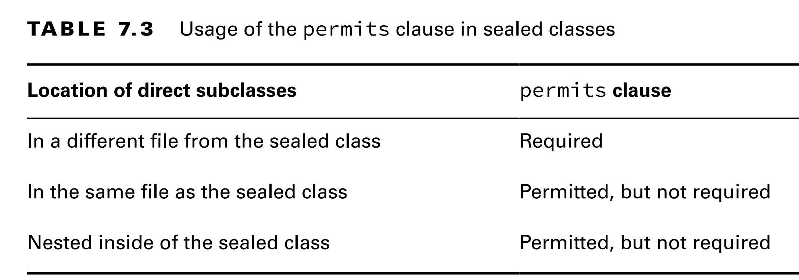
New things
Referencing nested subclasses
- To use ... clause in ..., we must follow ...
- If we don't follow, ...
(code illustration snippet 47)
– If we follow, ...
(code illustration snippet 48)

Slide 25
New things
Sealing interface
- Sealed inferface is ... but with an additional ..., which is the list will now contain ...
(code illustration snippet 49)
- Note: interface can't marked ...
(books also contains an example about pattern ...)
Encapsulating data with Record
Understanding encapsulation
- POJO is ...
- JavaBean is ...
(question 1)
(code illustration snippet 50)
- This class has terrible ...
(code illustration snippet 51)
- To have better encapsulation, ... (code illustration snippet 52)

Slide 26
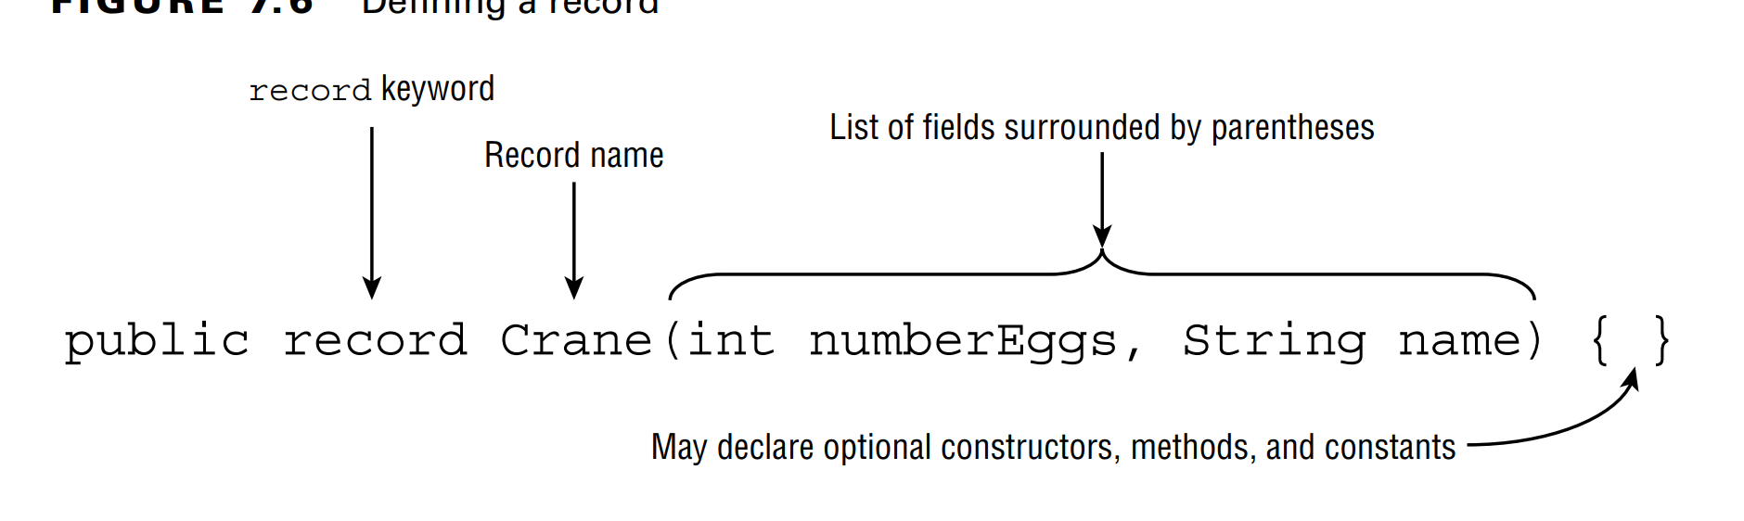
New things
(question 2)
Applying Record
- The previous class is ... => We can ... using Record

Slide 27
New things
- Compiler also puts ... into ....
– If we have multiple ... => ... => ...
- If we change ... => we also need to ... => ...
(code illustration snippet 53)
(code illustration snippet 54)
Some methods that added into Record:
+)
+)
+)
+)
+)
(code illustration snippet 55,56)

Slide 28
New things
Understanding Record Immutability
- Because Record is ... => All ... are ...
(code illustration snippet 57)
- Record also implicitly ...
– Record can't ... other
- Like ..., Record can ... other ...
(code illustration snippet 58)
Declaring constructor
- If we want to validate ..., we can ...
The long constructor
- The first way to do it is to ... (this is the type of ... that the compiler ...)
(code illustration snippet 59)
- Compiler won't ... if we ... Also, if any field isn't ... => ...
(code illustration snippet 60)
- However, this method become ... when we have ...

Slide 29
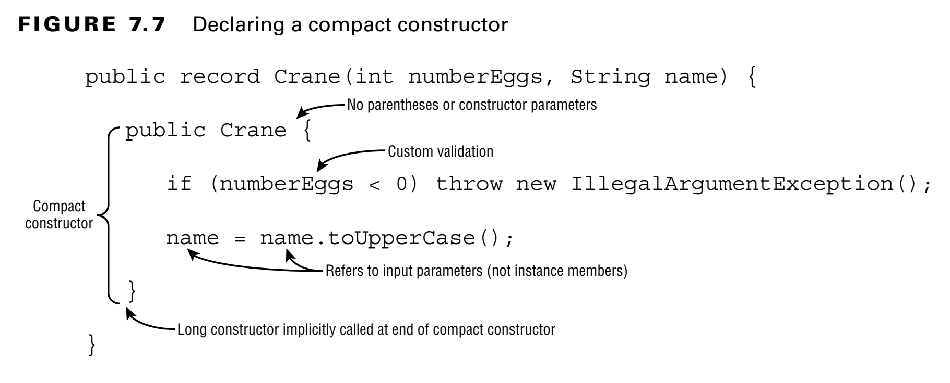

New things
- The 2nd method: ... Constructor
- Compact Constructor is ... of .... for ... purpose
- If we use ... name => ...
- Note: At the end of ..., Java will ... (specified in JLS)

Slide 30
New things
Transforming Parameters
(code illustration snippet 61)
- If we try to use "this" => ...
(code illustration snippet 62)
- Java recommends us to ..., we only use ...
Overloaded constructors
- We still can ... like normal
(code illustration snippet 63)
- If there are no other ... => we have to ...
(code illustration snippet 64)

Slide 31
New things
Customizing Records
- Record also supports .... like ...
+)
+)
+)
(code illustration snippet 65)
- Because Record is ... => We can't add any ... but we can ... const
(code illustration snippet 66)
- Record also doesn't support ... init ...
- Even if Record contains ..., we should keep ...

Slide 32
New things
Creating Nested Classes
- Nested class is ...
– There are ... types of nested class
+)
+)
+)
+)
– Inner class has many ... for example we can create a ... class that can be used ... => Better ... Or we can create ... can be used only ... => Make code ...
- Note: The book uses "nested class" for ...
Declaring an Inner Class
- Inner class is ...
- It can use ... modifiers
- Some characteristics of Inner Class
+) +) Can ... class or ...
+) +) Can access ...

Slide 33
New things
(code illustration snippet 67)
- Because Inner class isn't => A ... is required (proof on next section)
- In Java 11, only ... class can have ... => But when Java 16 release ... => ... class can now have ... method
Instantiating an Instance of an Inner Class
- There is another way to ...
(code illustration snippe 68,69)
Note: When we run javac with ... => It will create ... files => One with ... and one with ... including the ... sign
- This is the reason why people always say ...
Referencing members of an Inner class
- Inner class can have same ..., however, the syntax ...
(code illustration snippet 70)
Proof of inner class instantiation requirement
(code illustration snippet 71)

Slide 34
New things
- To prove this, we need to learn some new terminologies
Qualified "this"
- We have class A, and class B (where B is ...)
- We use "this" in ...
- JLS specify that when we .... B, there will be "n" ... created (in this case ...) (we won't prove this because it is extremely complicated to prove this)
- Java call these ... as ...
- To refer to ..., we use "qualified this". The syntax is <?>.<?>??? (note that this doesn;t include ...)
Primary expression
- JLS defines Primary expressions is all ... including ...
Qualified instance creation expression
-JLS defines this as ... + ... => It means ... + ...
Therefore, how does JLS define ... ?

Slide 35
New things
1) If inside ...
+) If the ... is unqualified => If it is inside ... =>
2) If inside another
+) if the ... is unqualified => ...
2) If inside ...
+) If ... is qualified => Instance still ... but static ...
(in general, this is very hard to prove)
Creating a static Nested class
- Nested static class is ...
– Nested static class can't access ... because it requires ... this ...
– It doesn't require ... create ...
(code illustration snippet 72)

Slide 36
New things
Writing a Local class
- Local class is ...
- Its scope is same ...
- We can only ... and use ... inside ...
– We can return ... (however, we need to use ...)
- Note: Local class can .. everywhere
- Here are the following properties of local class
+)
+)
+) access to local ... (only when ...)
+) access to ... when ... method
(code illustration snippet 73)
(code illustration snippet 74)

Slide 37
New things
- Why can local classes can only access "final" or "effectively final" variables
– This is because when we use javac, ..... Therefore, ... class can't find a way to ... variable in the ... class
– But if that variable is ... or ...=> Java can ... to the ... of the ... class as a parameter and assign ...
- If the variable isn't ... =>
(question 3)
Defining an Anonymous class
- An anonymous class is ... local ... because
– It is ...ed and ...ed in a single ... with a new ..., type ...
– Anonymous class must ... or ... beforehand
(code illustration snippet 75,76)
- Anonymous class can't both ... and ... (except when it implements ... => it auto... JLS)
- Anonymous class can also be ... field
(code illustration snippet 77)

Slide 38
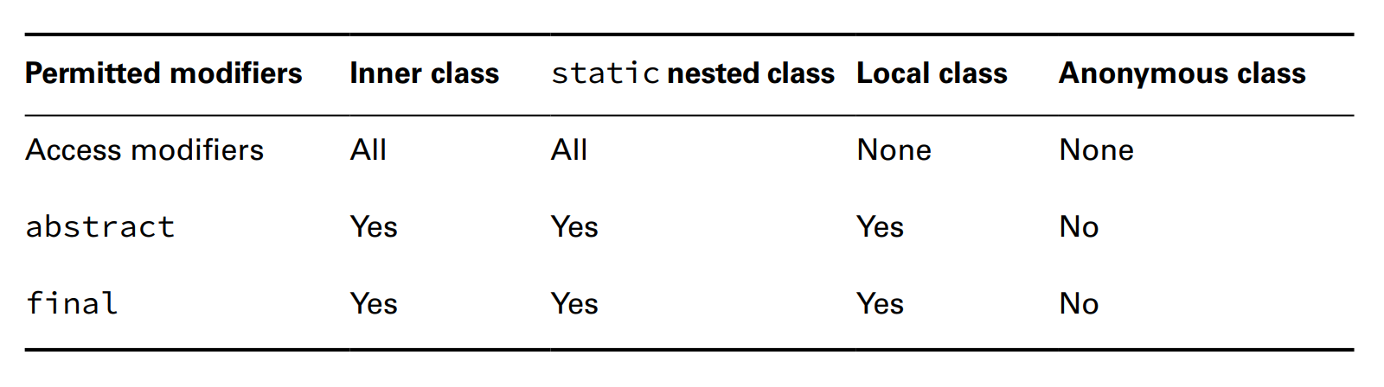
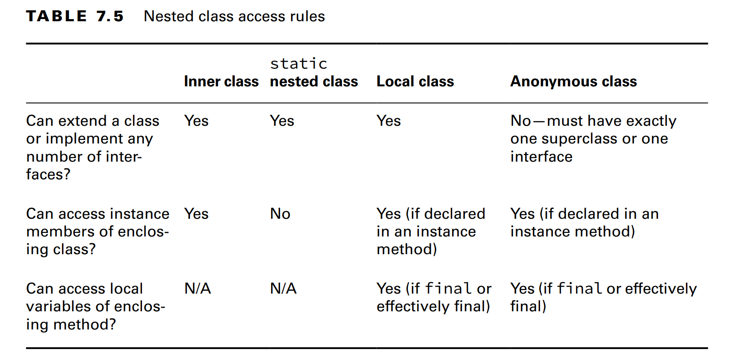


New things

Slide 39
Reviewing Polymorphism
- Downcast needs ...
- Answer this question using the provided snippet: Why did this code not compile ?
(code illustration snippet 78)

